Slide 1

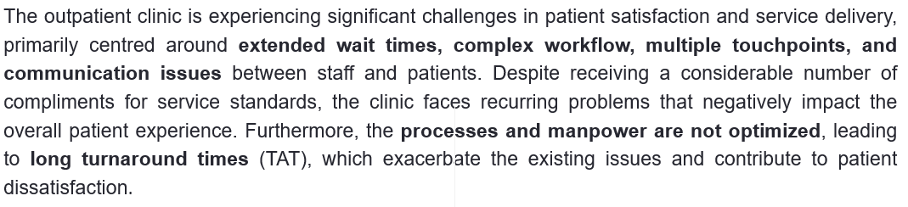
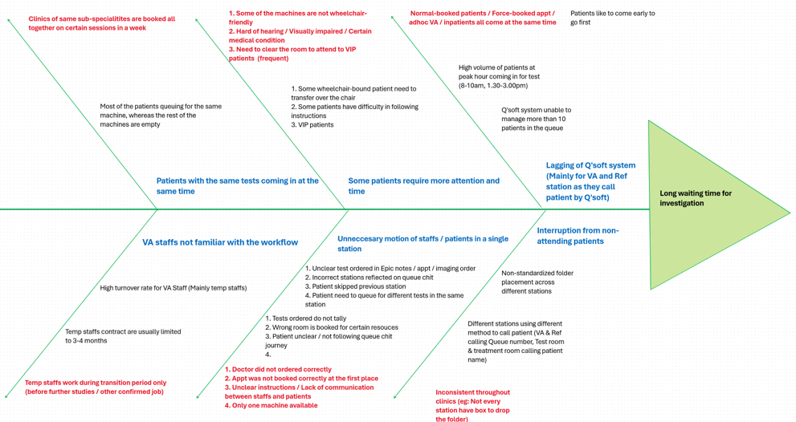
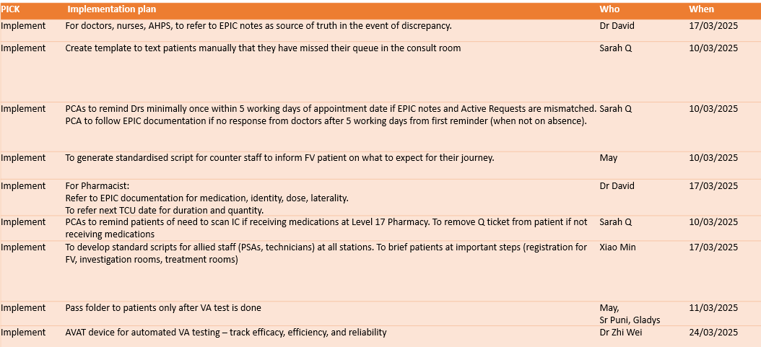
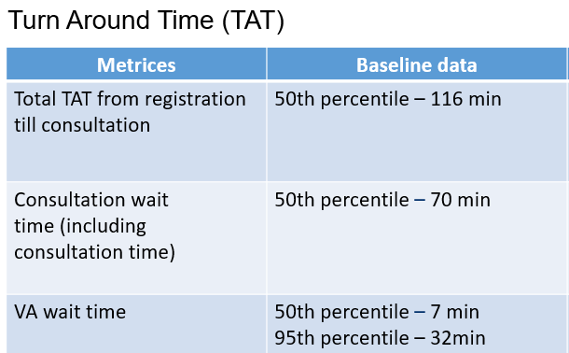
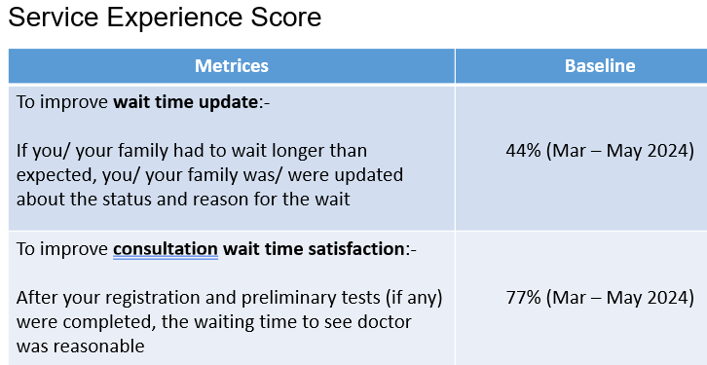
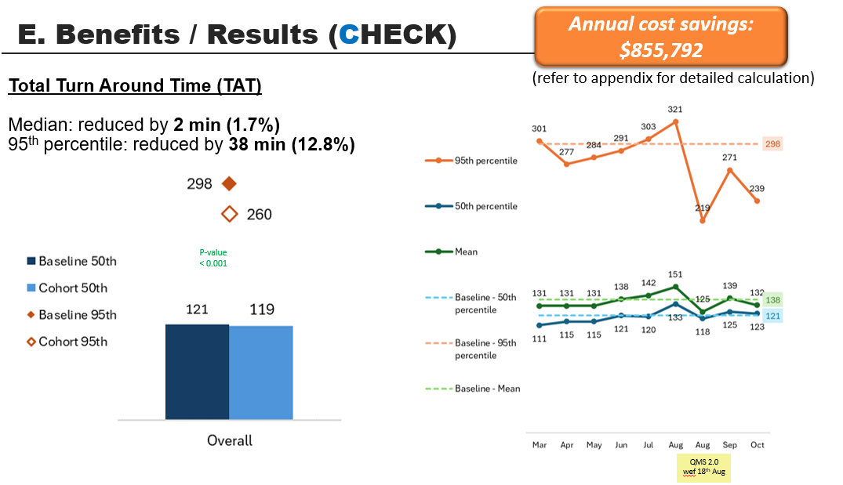
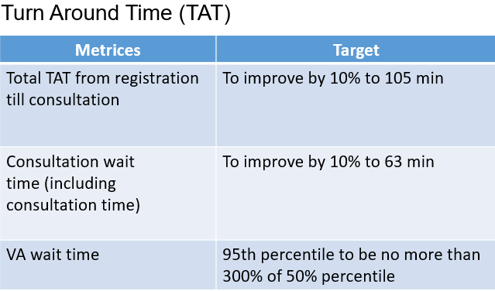
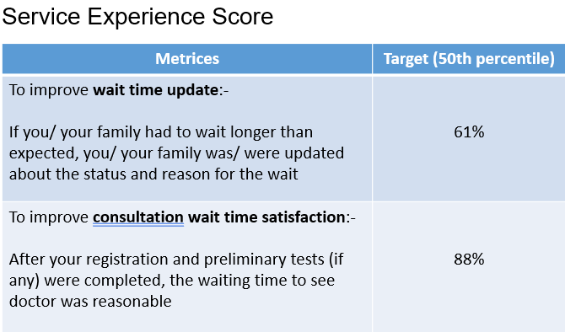
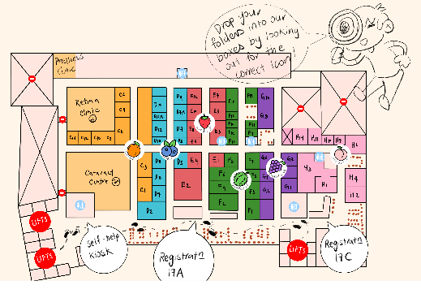
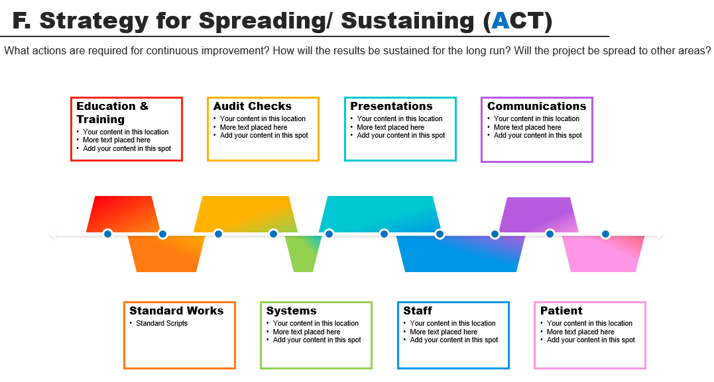
Project Title: OPTICS: Optimizing Processes for Treatment, Improving Care & Satisfaction
Department: Ophthalmology | Period: Feb 2025 – Dec 2025 | Facilitator/s: Lee Lay Pei, Goh Shi Min, Tania (Advisor: Jay Tan)
Sponsors (HODs):Prof Victor, Dr Charmaine, Perrine Lee | Team Leader/s: Dr David Chen
1. Reasons for Action | 4. Problem Analysis | 7. Completion Plan
2. Initial State | 5. Solution Approach Tools used as follows ✓ Lean methodologies: Gap Analysis, Cell concepts, Standard Work Design thinking: Persona, VSEM ✓ Future VSM | 8. Confirmed State
3. Target State | 6. Rapid Experiment and Prototype | 9. Insights

Slide 2
Project Team Composition
Sponsor:
A/Prof Victor Koh (HoD, Ophthalmology)
Dr Charmaine Chai (Senior Consultant, Ophthalmology)
Perrine Lee (Head, Operations, Ophthalmology)
QI Sponsor:
Roy Ngong (Asst COO, Plans and Strategy)
Facilitators:
Lee Lay Pei (Senior Assistant Manager, Quality Improvement)
Goh Shi Min (Head, Ops & Planning Section, Ophthalmology)
Tania Miglani (Manager, Corporate Infrastructure Office)
QI Advisors:
Jay Tan (Senior Manager, Quality Improvement)
Team Leader:
Dr David Chen Ziyou (Consultant, Ophthalmology)
Members (max. 14 excluding 1 leader):
Clinician : Dr Lim Zhi Wei (Resident, MOHH)
Nurses : Sister Punithavathi, Sister Bing Caixia
Optometrist: Keli Lor, Jacquelin Liew
Technician : Gladys Loh, Germaine Lau
PSA/STL : May, Sarah Qurratu'aini
Scheduler : Iris Guo
Operation : Neo Xiaomin, Lin Zhaoting, Samuel Tay
Pharmacist : Sarah Serrano
Invitees:
Pauline Chua, Tan Ban Thong, Alvin Yong, Sandy Koh (NUHS Corp HR)
Corene Poh (NUHS Corp, Group digital office)
Angela Heng, Quek Mei Yin, Kimberly (Service Transformation)

Slide 3
Sample 3
A. Define the Problem (PLAN)
The outpatient clinic is experiencing significant challenges in patient satisfaction and service delivery, primarily centred around extended wait times, complex workflow, multiple touchpoints, and communication issues between staff and patients. Despite receiving a considerable number of compliments for service standards, the clinic faces recurring problems that negatively impact the overall patient experience. Furthermore, the processes and manpower are not optimized, leading to long turnaround times (TAT), which exacerbate the existing issues and contribute to patient dissatisfaction.

Slide 4
Sample 3
B. Goal (PLAN) Set SMART goals | Specific, Measurable, Achievable, Relevant, Time-based |
Turn Around Time (TAT)
Metrices | Baseline data | Target
Total TAT from registration till consultation | 50th percentile – 116 min | To improve by 10% to 105 min
Consultation wait time (including consultation time) | 50th percentile – 70 min | To improve by 10% to 63 min
VA wait time | 50th percentile – 7 min 95th percentile – 32min | 95th percentile to be no more than 300% of 50% percentile

Slide 5
Sample 3
B. Goal (PLAN) Set SMART goals | Specific, Measurable, Achievable, Relevant, Time-based |
Service Experience Score
Metrices | Baseline | Target (50th percentile)
To improve wait time update:- If you/ your family had to wait longer than expected, you/ your family was/ were updated about the status and reason for the wait | 51% (Mar – May 2024) | 61%
To improve consultation wait time satisfaction:- After your registration and preliminary tests (if any) were completed, the waiting time to see doctor was reasonable | (Mar – May 2024) | 88%

Slide 6
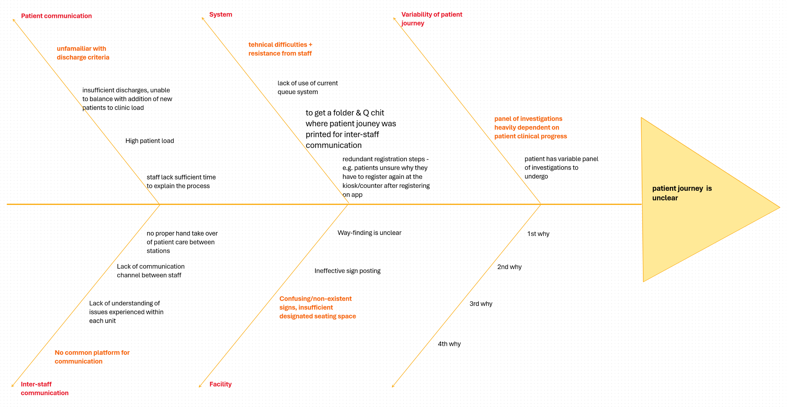
Sample 4
C. Problem Analysis (PLAN) Gap Analysis

Slide 7
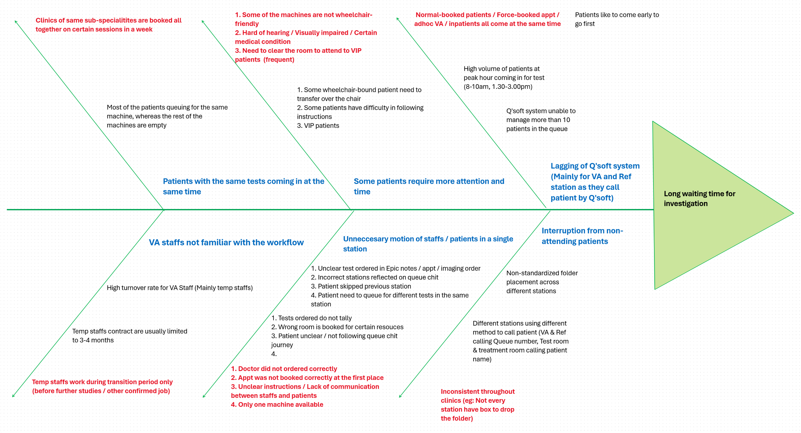
Sample 4
C. Problem Analysis (PLAN) Gap Analysis

Slide 8

Introducing our main 17A Eye Patient Persona
Overlooked Olivia
NEEDS
Repeat Visit, suffers from glaucoma, blurry vision, hard of hearing
Values comfort and empathetic service for elderly patients like herself.
I need more empathy, care and comfort due to my condition.
During the visit, I need a better way to be informed about my turn, what to do, where to go or wait for my turn.
PAIN POINTS
“I missed my turn because I couldn’t see and hear clearly. I also didn’t understand when or where to drop folder. There is no space for me to wait outside the room as the corridor is very crowded.”
Can’t see clearly the Q no. on the TV in the waiting area.
Can’t hear clearly the staff calling her name in the noisy environment. No Q no. display along corridor.
Can’t find a seat at the corridor to wait nearer to the VA and consult room.
Notes:
FV (PR, unknown medical condition, language barrier)
“Why I clicked "I had arrived" but still need to take q number?”
"The staff asked me to wait, wait for what?"
"Counter staff didn't explain the instructions clearly“
- Pain point: don’t understand folder
RV (glaucoma, blurry vision, hard of hearing)
"Q numbers were not following sequence“
“Couldn't see the q no. flagged on TV hence missed Q.”
"not enough seats and crowded at the corridor"

Slide 9
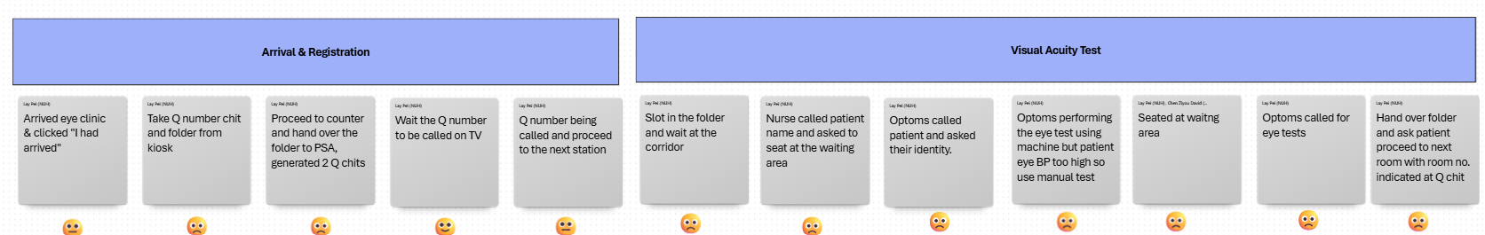
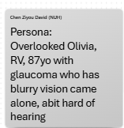
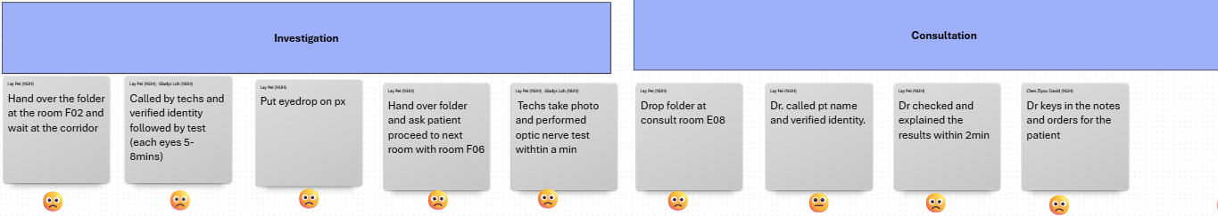
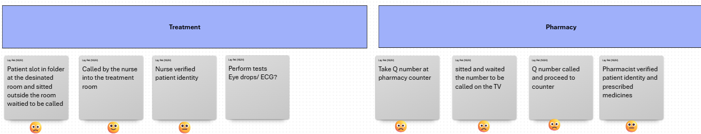
C. Problem Analysis (PLAN) Value Stream Map
Patient’s Journey

Slide 10
D. Interventions & Action Plan (DO)
PICK | Implementation plan | Who | When
Implement | For doctors, nurses, AHPS, to refer to EPIC notes as source of truth in the event of discrepancy. | Dr David | 17/03/2025
Implement | PCAs to remind Drs minimally once within 5 working days of appointment date if EPIC notes and Active Requests are mismatched. PCA to follow EPIC documentation if no response from doctors after 5 working days from first reminder (when not on absence). | Sarah Q | 10/03/2025
Implement | To generate standardised script for counter staff to inform FV patient on what to expect for their journey. | May | 10/03/2025
Implement | For Pharmacist: Refer to EPIC documentation for medication, identity, dose, laterality. To refer next TCU date for duration and quantity. | Dr David | 17/03/2025
Implement | PCAs to remind patients of need to scan IC if receiving medications at Level 17 Pharmacy. To remove Q ticket from patient if not receiving medications | Sarah Q | 10/03/2025
Implement | To develop standard scripts for allied staff (PSAs, technicians) at all stations. To brief patients at important steps (registration for FV, investigation rooms, treatment rooms) | Xiao Min | 17/03/2025
Implement | Pass folder to patients only after VA test is done | May, Sr Puni, Gladys | 11/03/2025
Implement | AVAT device for automated VA testing – track efficacy, efficiency, and reliability | Dr Zhi Wei | 24/03/2025

Slide 11
D. Interventions & Action Plan (DO)
PICK | Implementation plan | Who | When
Choose | Paeds Refraction patients to go D02 instead of D01. Workflow already in place, work offline to ensure all PSAs are aware. | Sarah Q | 10/03/2025
Choose | Remind doctors to not order VA if patient requires refraction. | Dr David | 17/03/2025
Choose | Counter to generate specialised itinerary for FV patient. | May | 10/03/2025
Choose | To remove written notes indicating "Pharm/Home" on queue chit for patients with investigations as their last station. | Gladys | 17/03/2025
Choose | To improve SOP for ad hoc room changes - Room SAs to map room changes, to communicate to counter IC. | Iris | 24/03/2025
Choose | Pharmacy Standardised workflow: Teams message to Dr > wait 5 mins > if no response, to call on mobile 1X. If unable to reach > send back to clinic immediately. | Dr David Sarah (Pharmacist) | 17/03/2025
Choose | To identify trend in frequent/ common room change requests and propose to Dr Charmaine for future changes. | Iris | 24/03/2025
Choose | Pharmacy: To work with pharmacy ops to improve the visibility of the signage at pharmacy counter. | Sarah (Pharmacist) | 24/03/2025

Slide 12
D. Interventions & Action Plan (DO)
PICK | Implementation plan | Who | When
Plan | Standardized default sequence of patient calling. Only patients in immediate sequence (e.g. 2-3 pts) are let in to waiting area outside rooms. Bulk of patients to wait at main waiting area | Dr David Sarah Q | 17/03/2025
Plan | To identify which machine is wheelchair friendly - work with vendors to explore if machines can be fitted on wheelchair friendly table | Germaine | 02/06/2025
Plan | To improve on patient folders. - Add mini map of the clinic and factsheet, and paste on the back of the clear folders. - To reword instructions on folder on folder dropage - To ensure that it is updated timely, with time/date stamp of last update. | Xiao Min | 02/06/2025
Plan | Establish strict window period for registration (e.g. 1 hour before appt time) to discourage patients from arriving unnecessarily early | May | 05/01/2026

Slide 13
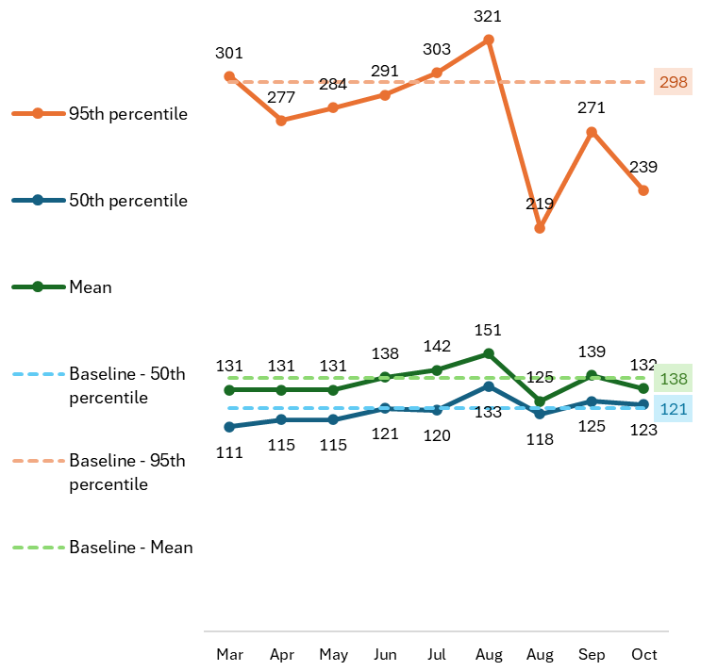
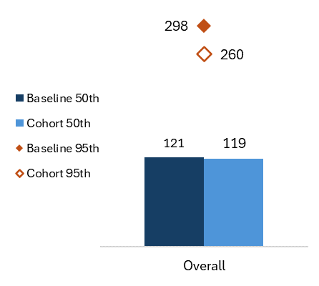
E. Benefits / Results (CHECK)
Annual cost savings: $855,792
Total Turn Around Time (TAT)
Median: reduced by 2 min (1.7%)
95th percentile: reduced by 38 min (12.8%)
(refer to appendix for detailed calculation)
P-value
< 0.001
QMS 2.0
wef 18th Aug

Slide 14
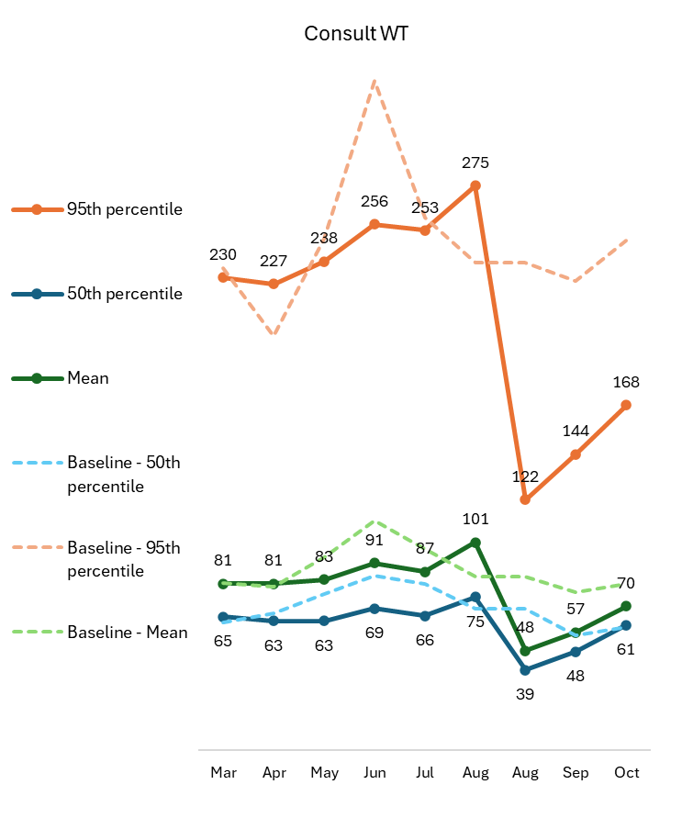
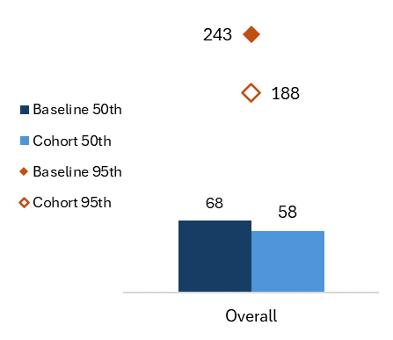
E. Benefits / Results (CHECK)
Consultation wait time
Median: reduced by 10 min (14.7%)
95th percentile: reduced by 55 min (22.6%)
P-value
< 0.001
QMS 2.0
wef 18th Aug

Slide 15
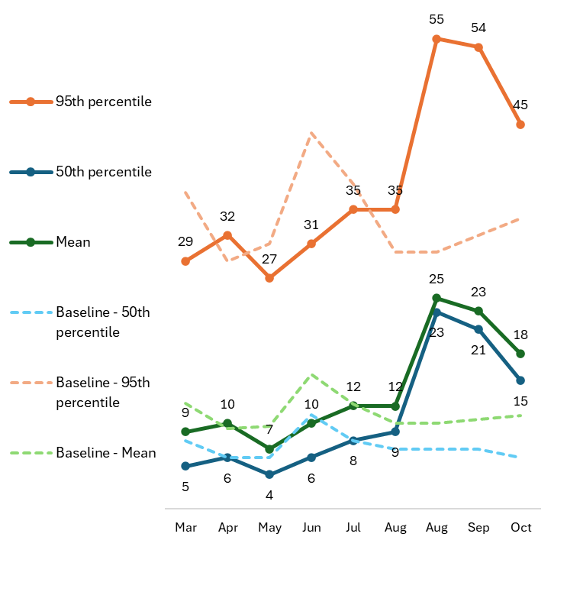
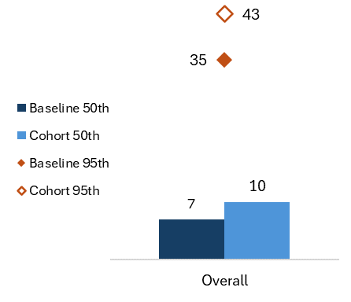
E. Benefits / Results (CHECK)
VA wait time*
Median: increased by 3 min (42.8%)
95th percentile: increased by 8 min (22.8%)
P-value
< 0.001
QMS 2.0
wef 18th Aug
*Baseline data may have been spuriously low as it was discovered that prior to QMS2.0, staff were transferring queue number out before patients were done with the station.

Slide 16
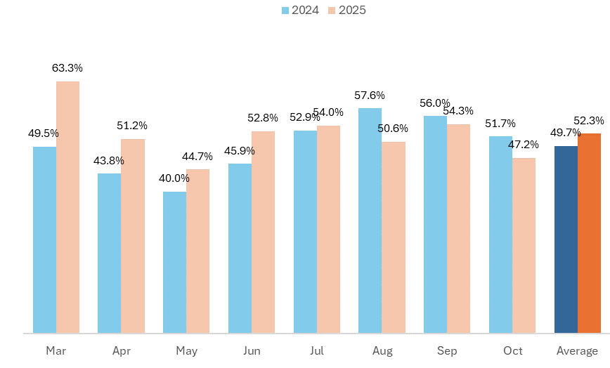
E. Benefits / Results (CHECK)
Service Experience Score (Wait Time Update)
Target: 61%
The introduction of QMS2.0 might have adversely affected the Service Experience Score temporarily
QMS 2.0
wef 18th Aug

Slide 17
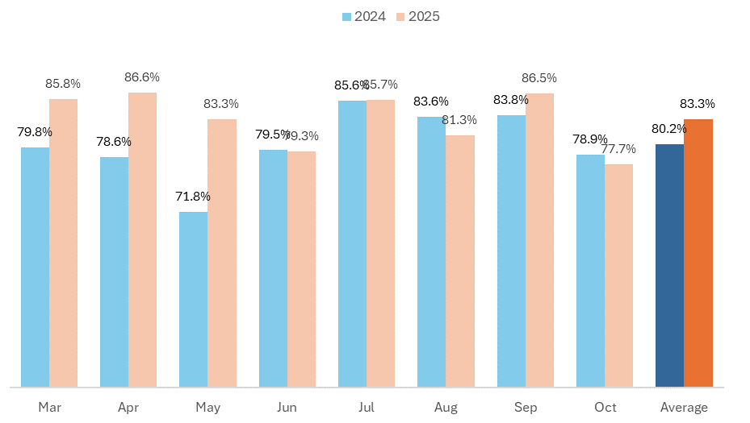
E. Benefits / Results (CHECK)
Service Experience Score (Consultation Wait Time Satisfaction)
Target: 88%
QMS 2.0
wef 18th Aug

Slide 18
Sample 5
F. Strategy for Spreading/ Sustaining (ACT)
What actions are required for continuous improvement? How will the results be sustained for the long run? Will the project be spread to other areas?
Education & Training
Your content in this location
More text placed here
Add your content in this spot
Audit Checks
Your content in this location
More text placed here
Add your content in this spot
Presentations
Your content in this location
More text placed here
Add your content in this spot
Communications
Your content in this location
More text placed here
Add your content in this spot
2005
2007
2008
2009
2010
2013
Standard Works
Standard Scripts
Systems
Your content in this location
More text placed here
Add your content in this spot
Staff
Your content in this location
More text placed here
Add your content in this spot
Patient
Your content in this location
More text placed here
Add your content in this spot

Slide 19
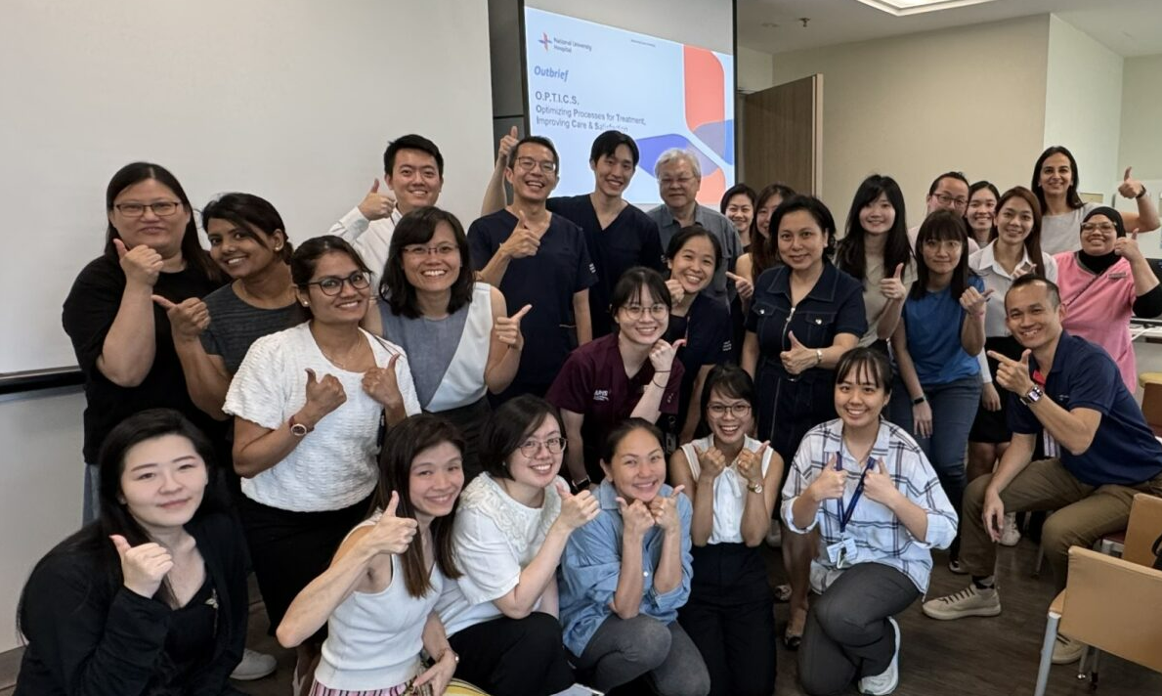
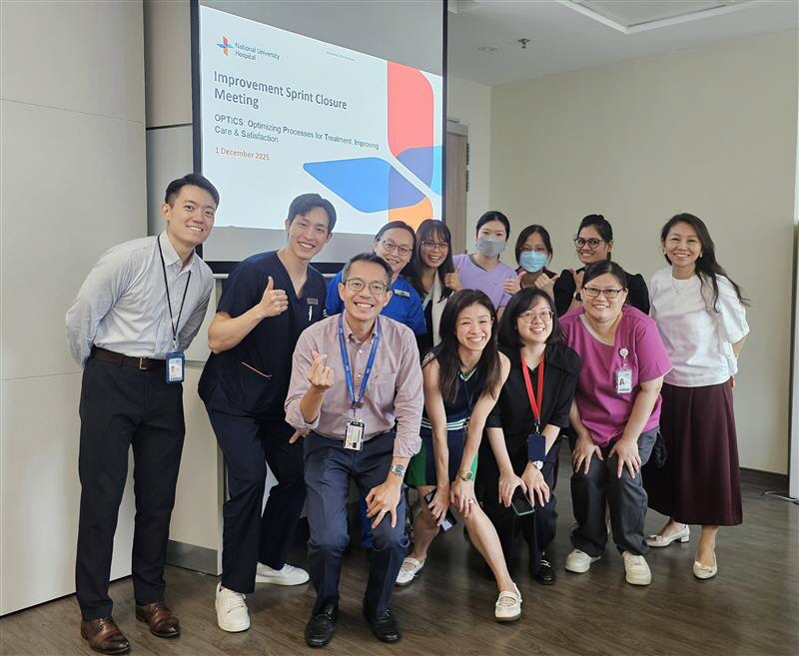
Sample 3
Appendix
Group photo during Improvement sprint
from 24-26 Feb 2025
Group photo during closure meeting on
1 Dec 2025

Slide 20
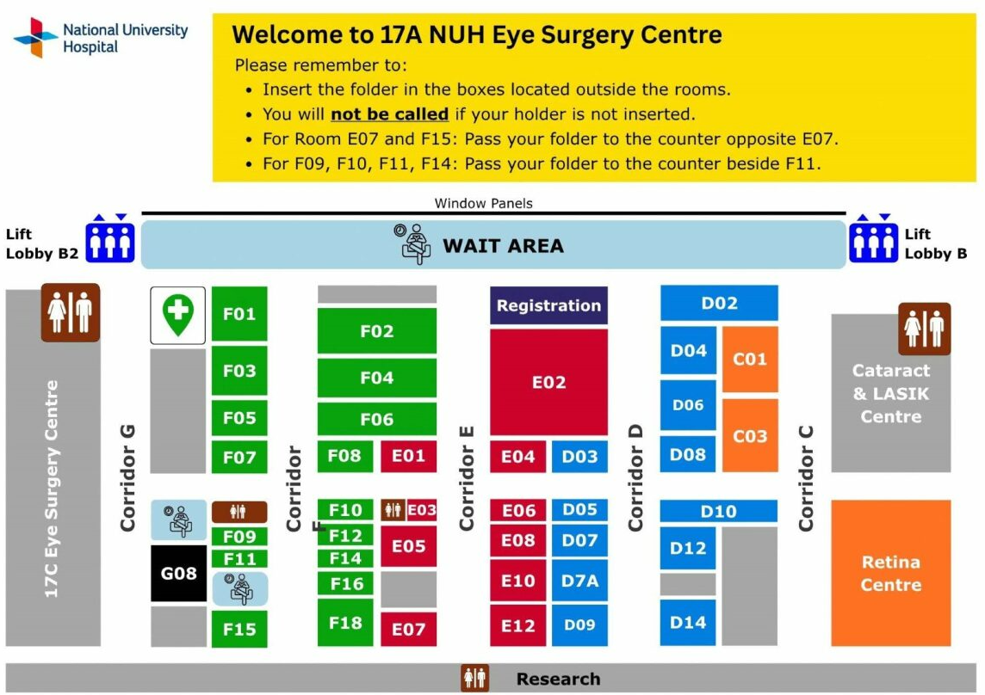
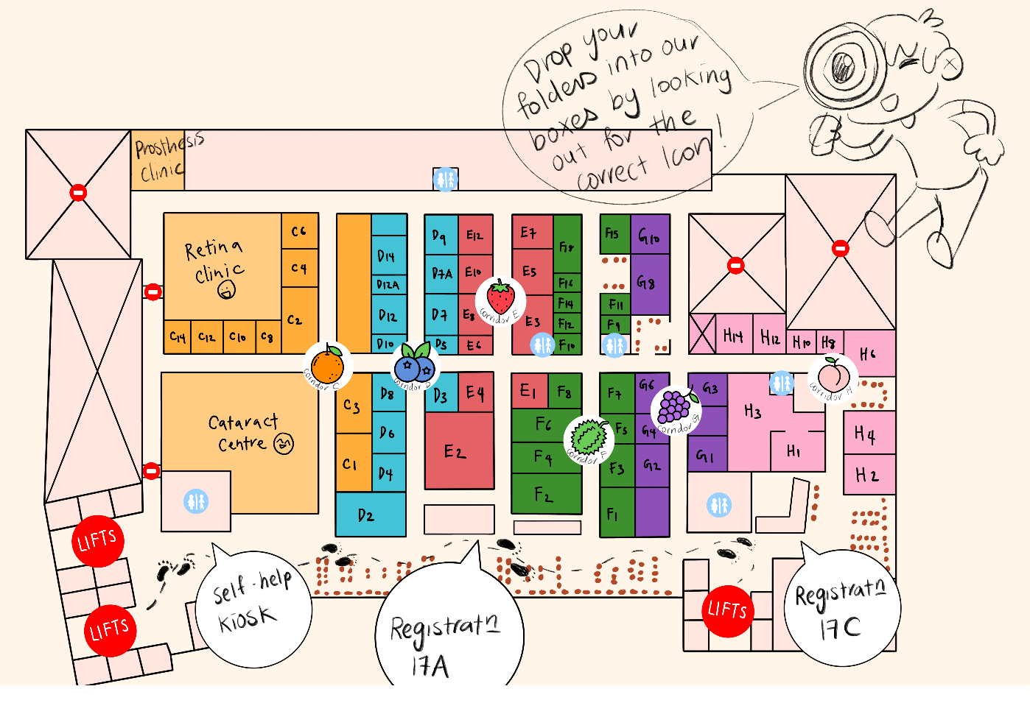
Sample 3
Appendix
Rapid Prototyping:
Feedback from patients in early testing for improvement in future iteration: Increase the legibility, e.g. font size
Highlight recognisable iconic landmarks to aid sense of orientation
Use lighter shades of color to increase contrast of font for legibility
Final version of mini map at Medical Centre Eye Clinic Level 17

Slide 21
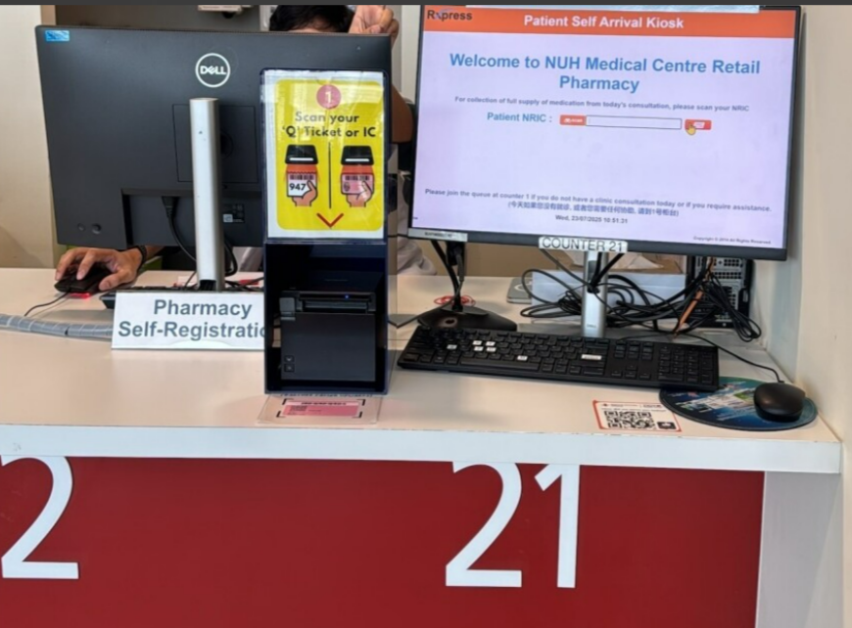
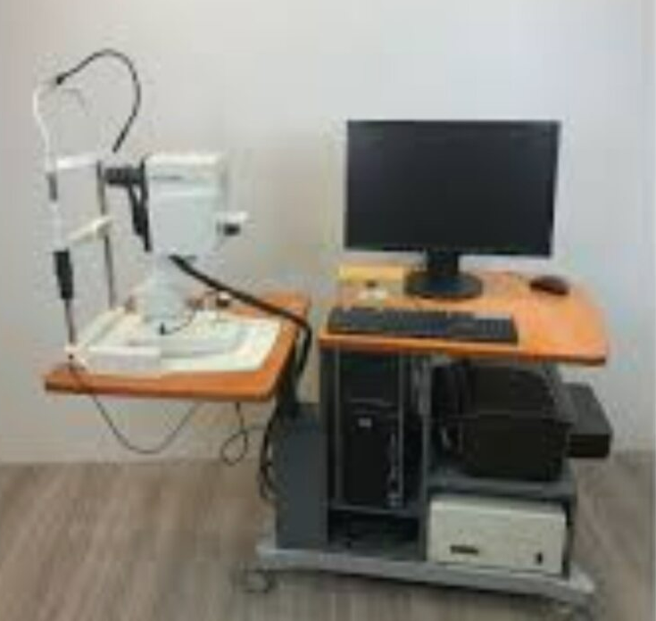
Sample 3
Appendix
Acrylic was installed at Satellite Pharmacy
Deployment of AVAT device for automated VA testing

Slide 22
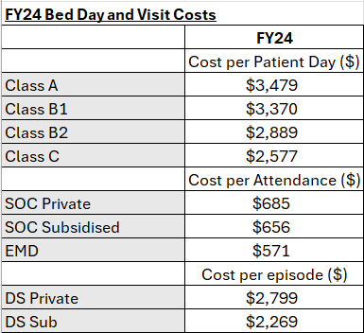
Sample 3
Appendix (Cost saving calculation)
Total TAT (registration to consultation completion): 116 min baseline → 114 min (2 min reduction)
Cost Savings:
Median TAT Improvement (2 minutes reduction)
Cost per patient visit = $656
Monthly average patient load = ~6,300 (based data from Feb25 to Nov25)
Time saved per patient: 2 minutes
Annual time saved: 6,300 x 12 × 2 min = 151,200 minutes (2,520 hours)
Cost per minute across full patient journey: $656/116 min (baseline) = $5.66/min
Annual cost savings: 151,200 min × $5.66 = $855,792

